Slide 1
Competitive Advantage for LG Contractors, Peace of Mind your customers.
www.LG-DFS-WARRANTY.com

Slide 2
Guaranteed Warranties
All LG Assurance Care extended warranties are Guaranteed and insured by an A rated underwriter as well as a secondary cumulative insurance policy.
Dealers Assurance Company (DAC)
DAC is a global leading insurance and investment organization
DAC carries an A.M. Best “A” (Excellent), Financial Size Category XIV
Pooled Secondary Insurance Policy
Notes:
Grow customer base
Customers locked = time to focus on growing the business
Warranty service contracts become an asset to your business
Differentiate your business
Additional value of LG over competitors
Add value to your services
Provide peace of mind to customers
Guaranteed long-term revenue stream
Tie your services to customers during warranty period
Additional Selling opportunities
Potential for $100 ADDITIONAL PROFIT ON EVERY SALE!
Average cost of warranty is $280
Average sale price for that warranty is $390-400

Slide 3
Extended Warranties
Extended warranties provide many benefits to contractors that strengthen their business and increase the bottom line.
Grow customer base
Customers locked = time to focus on growing the business
Warranty service contracts are an asset to your company
Differentiate your business
Additional value of LG over competitors
Add value to your services
Provide peace of mind to customers
Guaranteed long-term revenue stream
Tie your services to customers during warranty period
Additional Selling opportunities
Potential for ~$100 ADDITIONAL PROFIT ON EVERY SALE!
Average cost of warranty is $280
Average sale price for that warranty is $390-400
Notes:
Grow customer base
Customers locked = time to focus on growing the business
Warranty service contracts become an asset to your business
Differentiate your business
Additional value of LG over competitors
Add value to your services
Provide peace of mind to customers
Guaranteed long-term revenue stream
Tie your services to customers during warranty period
Additional Selling opportunities
Potential for $100 ADDITIONAL PROFIT ON EVERY SALE!
Average cost of warranty is $280
Average sale price for that warranty is $390-400

Slide 4
Increasing Sales / Profits
Average cost of warranty is $280. Average sale price for that warranty is $390-400.
That’s a minimum of $100 ADDITIONAL PROFIT ON EVERY SALE!
Over the life of the warranty there will be multiple opportunities to sell products and services.
Maintenance agreements, Out of warranty repairs, Additional services
Great opportunity to sell replacement system. (same or new home/business owner)
Assurance Care Plans allow you to make a mark-up on replacement parts
Purchase warranties up to 2 years after installation.
This allows you to retroactively sell warranties and lock in past or new customers who's equipment was installed within 2 years.
Differentiate from others not offering ESA.
Service Agreements become an ASSET to your company.
“Asset” customers add value to your company. The more you have locked in, the better!
Notes:
Now that we know how it works lets look at how to take advantage of it.

Slide 5
Increasing Your Average Sale
Crunch the numbers - Begin by figuring out the dollar value of your average sale. If you have 20 customers and total sales of $1,000 on a typical day, your average sale is $50. Then you can set a new target and plot your strategy to hit it.
Our extended warranties are a great pairing for equipment and allow you to make immediate profits on every sale without any cost to you the dealer!
Change your product or service mix - Adding or subtracting to what you sell can help grow your typical ticket size.
By Including extended warranties or other services/products you are adding higher-priced services to the mix.
Bundle your offerings - Encourage customers to spend more by giving them a package deal on multiple products or services
Bundle the extended warranty with maintenance agreements and accessories, such as an air cleaner.
Create weekly or monthly sales challenges - Focusing your sales team on a particular area for a week or a month can also generate add-on business.
Give spiffs to the sales person who sells the most equipment with extended warranties.
Notes:
So what does all this come down to? Increasing your average sale, which will increase your bottom line profits.
http://www.entrepreneur.com/article/191978

Slide 6
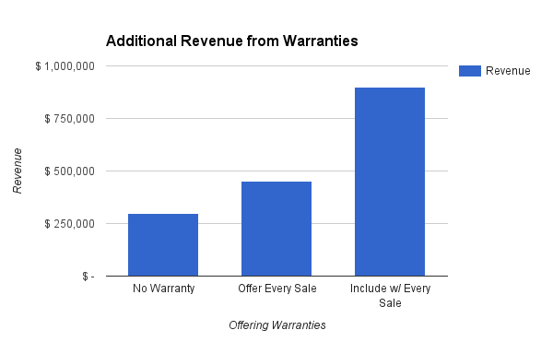
Increasing Average Sale
Opportunities for additional revenue.
Current without warranties
Average daily sales = $1000
20 customers per day = $50/sale
Apprx. 300 working days per year
Warranty as option
Including Warranties with every sale:
Average $100 additional revenue/sale
Average daily sales = $3000
Other Revenue opportunities
Maintenance agreements
Additional Selling opportunities
Notes:
Grow customer base
Customers locked = time to focus on growing the business
Warranty service contracts become an asset to your business
Differentiate your business
Additional value of LG over competitors
Add value to your services
Provide peace of mind to customers
Guaranteed long-term revenue stream
Tie your services to customers during warranty period
Additional Selling opportunities
Potential for $100 ADDITIONAL PROFIT ON EVERY SALE!
Average cost of warranty is $280
Average sale price for that warranty is $390-400

Slide 7
How to Sell
THE MOST EFFECTIVE WAY OF SELLING EXTENDED WARRANTIES IS TO NOT SELL THEM AT ALL!
INCLUDE the warranty in the price of the system or unit your are selling.
Customers are more likely to purchase the extended warranty if it is included in the sales price of the system up front.
“Add-On” sales are much less effective than inclusive sales.
ADVERTISE AND PROMOTE the fact that your equipment “Includes” the additional warranty coverage.
Warranty Cost ÷ Years Covered
Ex.) $390 ÷ 10yrs = $39/year or $3.25/month

Slide 8
LG Assurance Care Website
Complete Warranty Management Portal
Equipment Registration/Warranty purchase
Manage & track Claims
FAQ, marketing materials, & program documents

Slide 9
Want more info?
Login to LG-DFS-Warranty.com OR Contact LG Assurance Care Plan support for help getting started with LG’s exclusive extended warranty program.
Register or Login: www.LG-DFS-Warranty.com
Email: support@lg-dfs-warranty.com
Call: 1-855-543-9277

